Slide 1
Meeting 46

Slide 2
Agenda
US-CAMELS dataset
US-CAMELS related studies and variants
Plan

Slide 3
CAMELS
Catchment Attributes and Meteorology for Large-sample Studies
Coverage: 671 catchment across contiguous USA (minimally impacted by human activities)
Release date: 2014, last update: March 2016
Record length: 20 years (1990-2009)
Daily grided meteorological data (Daymet), daily streamflow data, metadata (location, evaluation, size, basin delineation shape-files), benchmark model performance (calibrated Sacramento model parameter sets, model output timeseries)

Slide 4
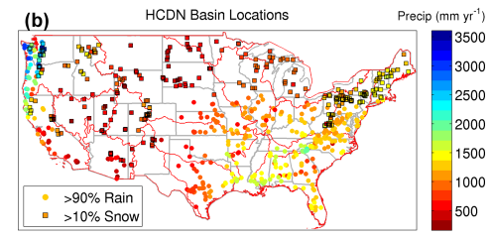
CAMELS
Daymet: daily gridded (1x1km) dataset over contiguous USA and southern Canada (available from 1980 to present): Daily maximum, minimum temperature, precipitation, shortwave downward radiation, day length, humidity.
https://daymet.ornl.gov/

Slide 5
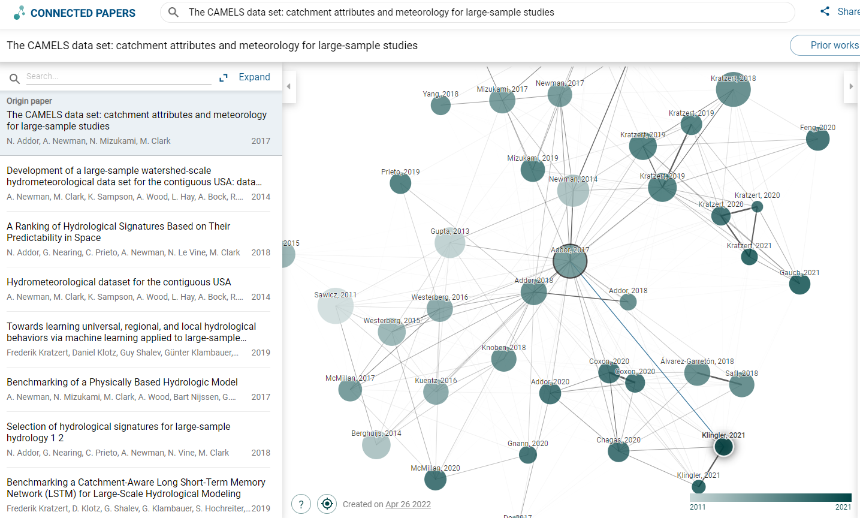
CAMELS related study

Slide 6
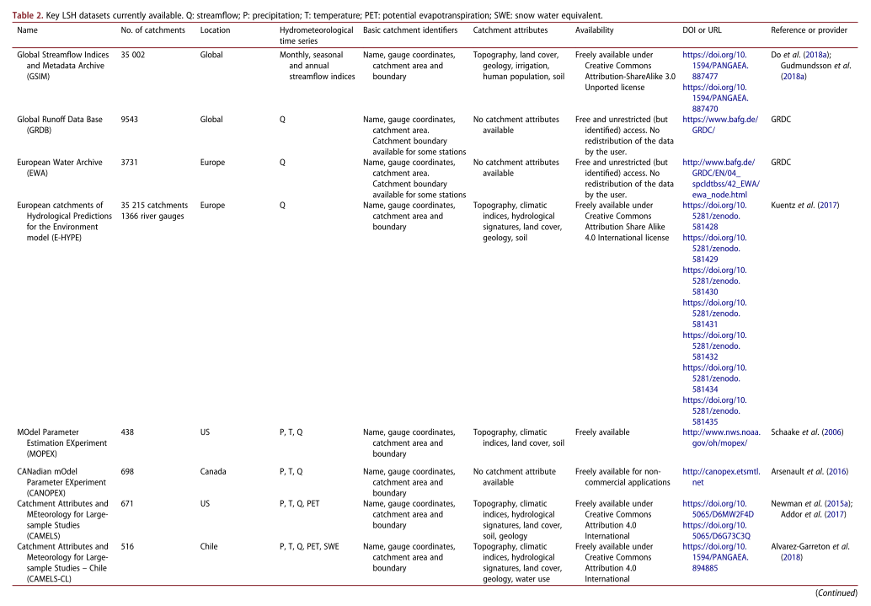
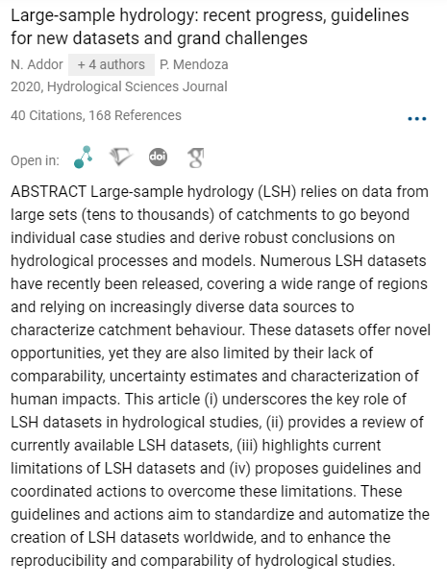
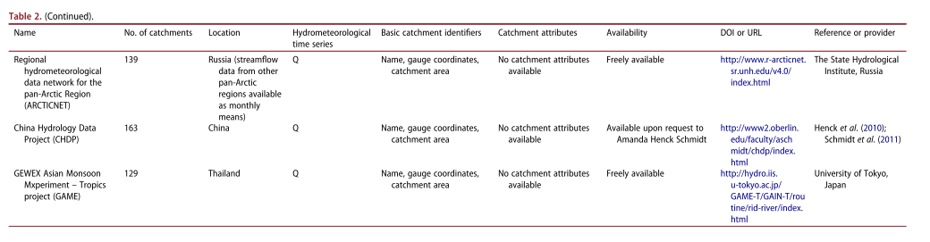
Large-sample hydrology review paper

Slide 7
CAMELS variants
CAMELS-GB (2020)
CAMELS-CL (2018)
CAMELS-BR (2020)
CAMELS-AUS (2021)
LAMAH-CE (2021): Large sample data for hydrology and environmental sciences for Central Europe (Austria, Germany, the Czech Republic, Switzerland, Slovakia, Italy, Liechtenstein, Slovenia and Hungary)

Slide 8
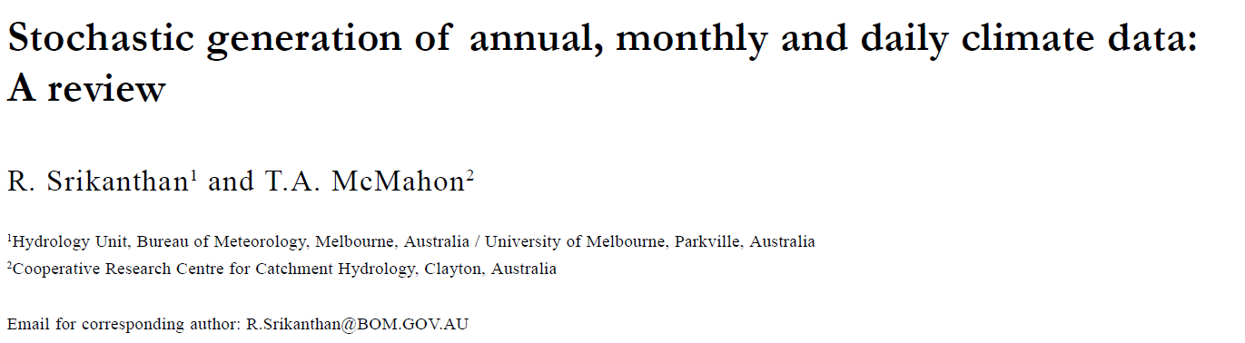

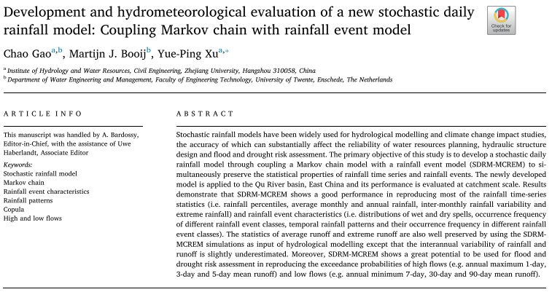
2nd SRM for study 1

Slide 9
Plan
Sensitivity analysis of PET
Coding up the 2nd SRM model
Colleting CAMELS data
Coding up objective function using kernel density estimation

